Slide 1
Voluntary Peoples Review of SDGs in Nepal (VPR Nepal 2020)
Amplifying Voices of the People: Closing the Gaps of SDGs
Daya Sagar Shrestha
SDGs National Network Nepal
Secretariat: National Campaign for Sustainable Development
21 January 2020

Slide 2
Review of VNR 2017
Not inclusive and participatory
CSOs inputs and contributions not included
CSOs produced separate report
No follow-up actions after HLPF in 2017
Issues raised are still unaddressed
Political ownership, localization, inclusive mechanisms, disaggregated data, civic space

Slide 3
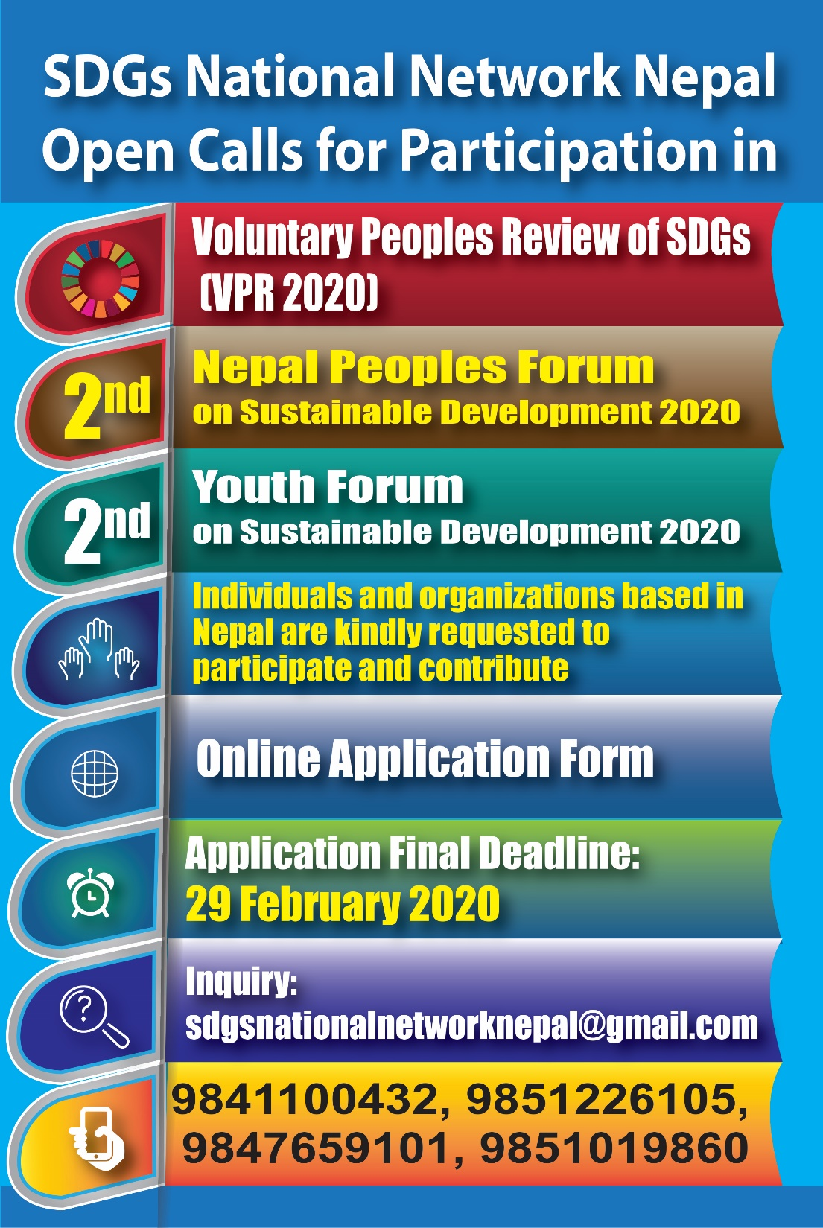

Slide 4
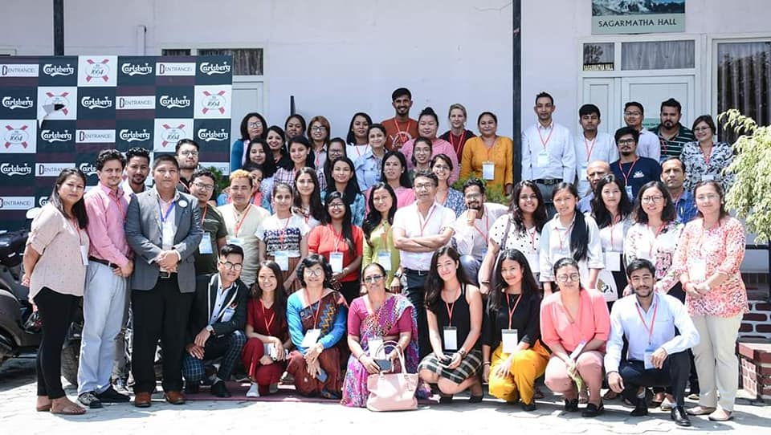
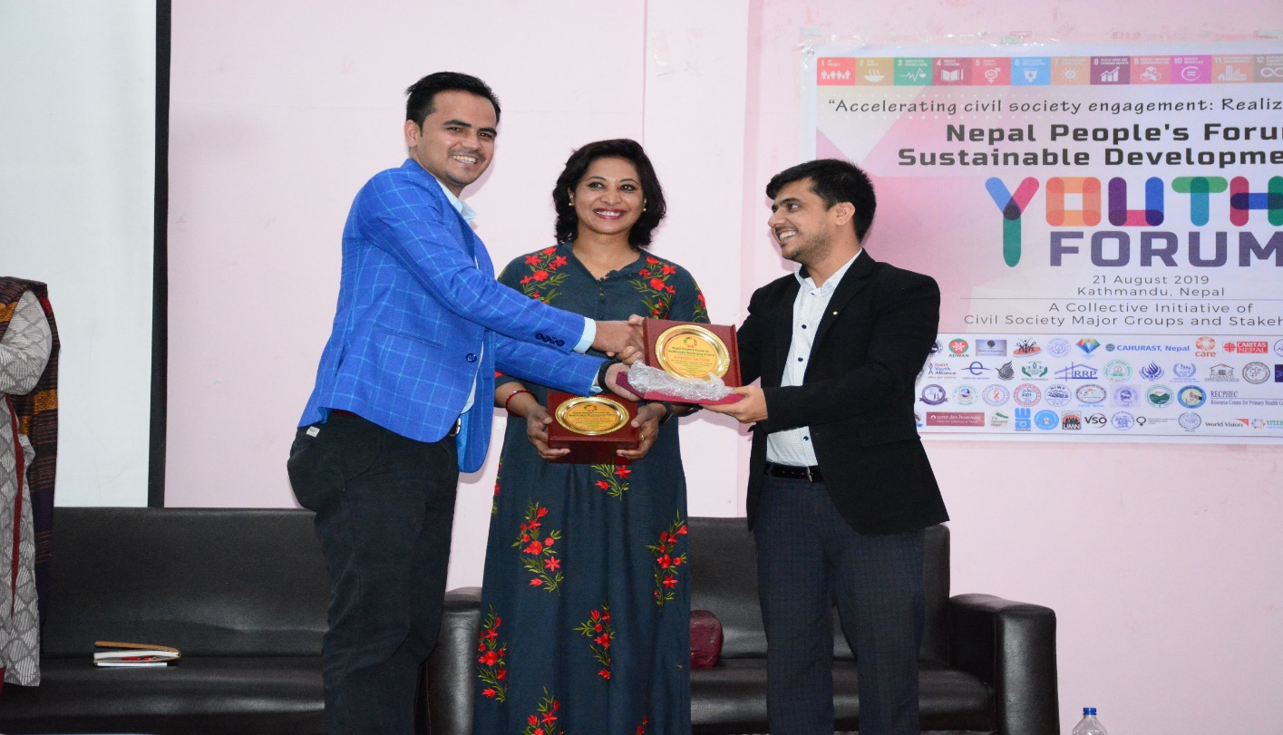
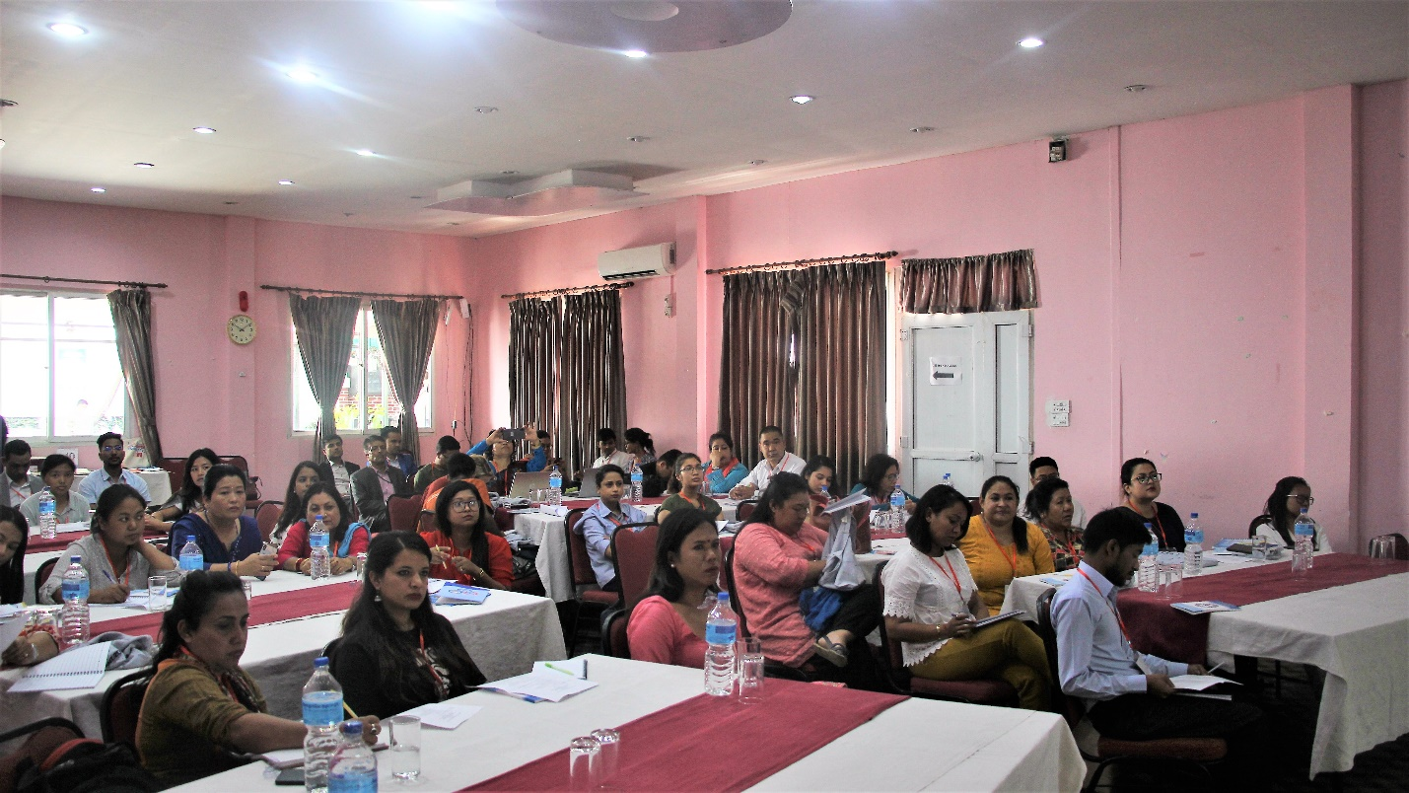
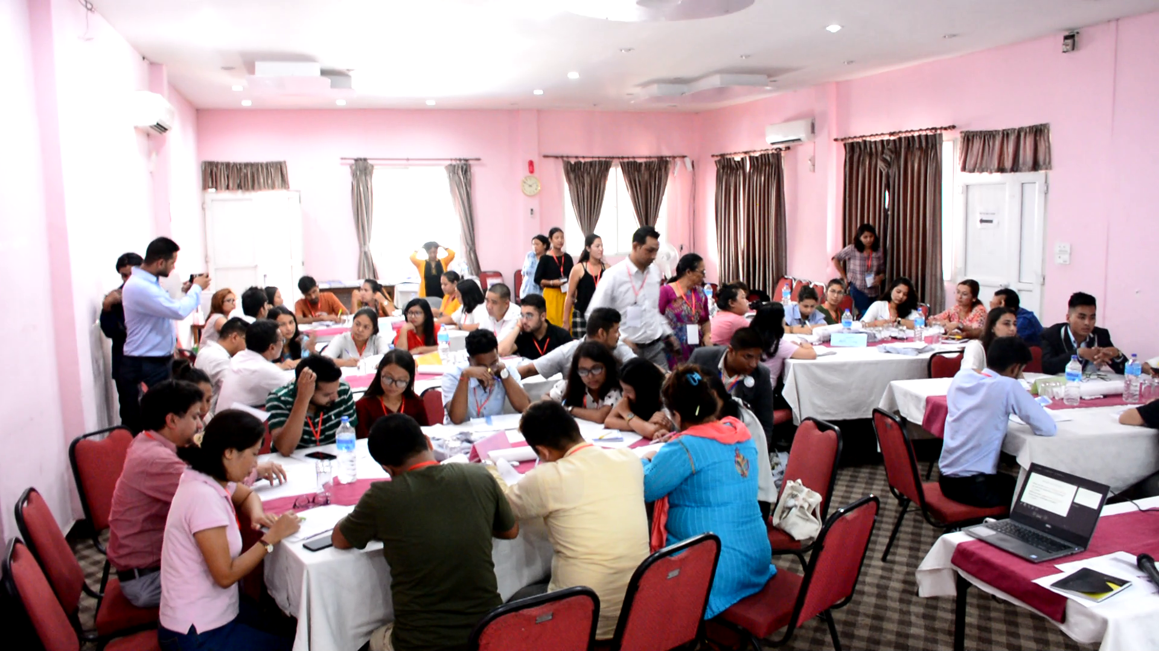
Evolution of SDGs National Network Nepal: 21 August 2019, Youth Forum

Slide 5
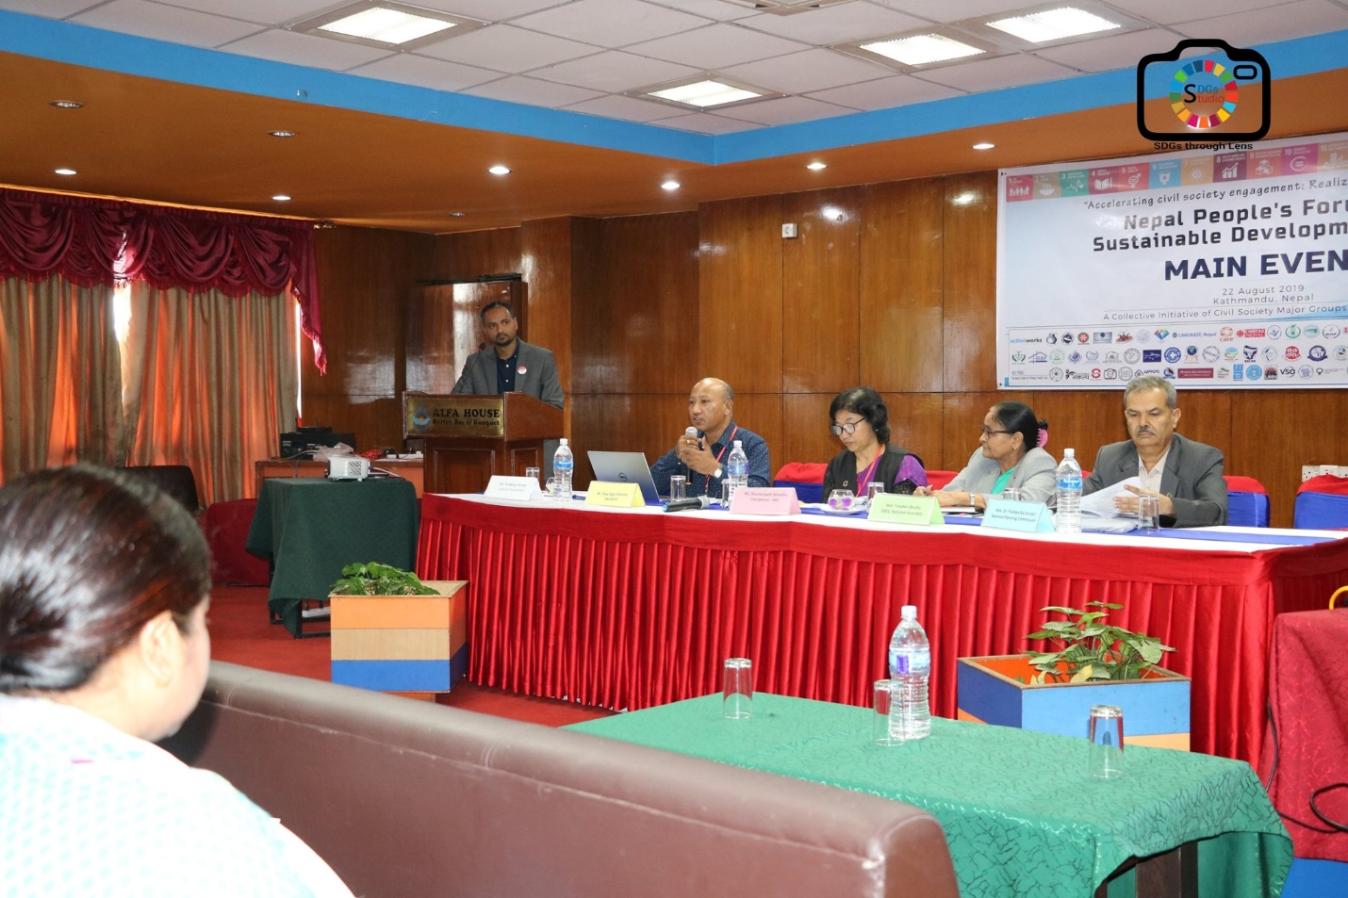
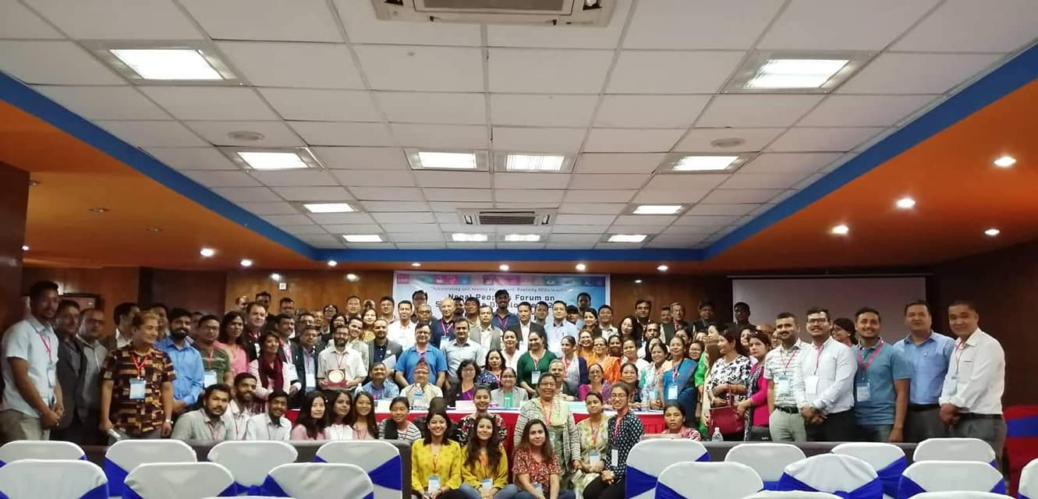
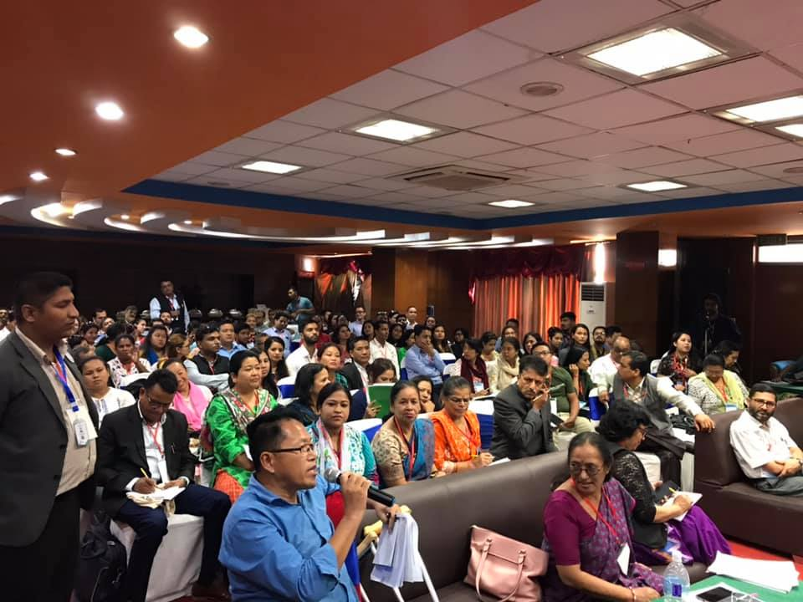
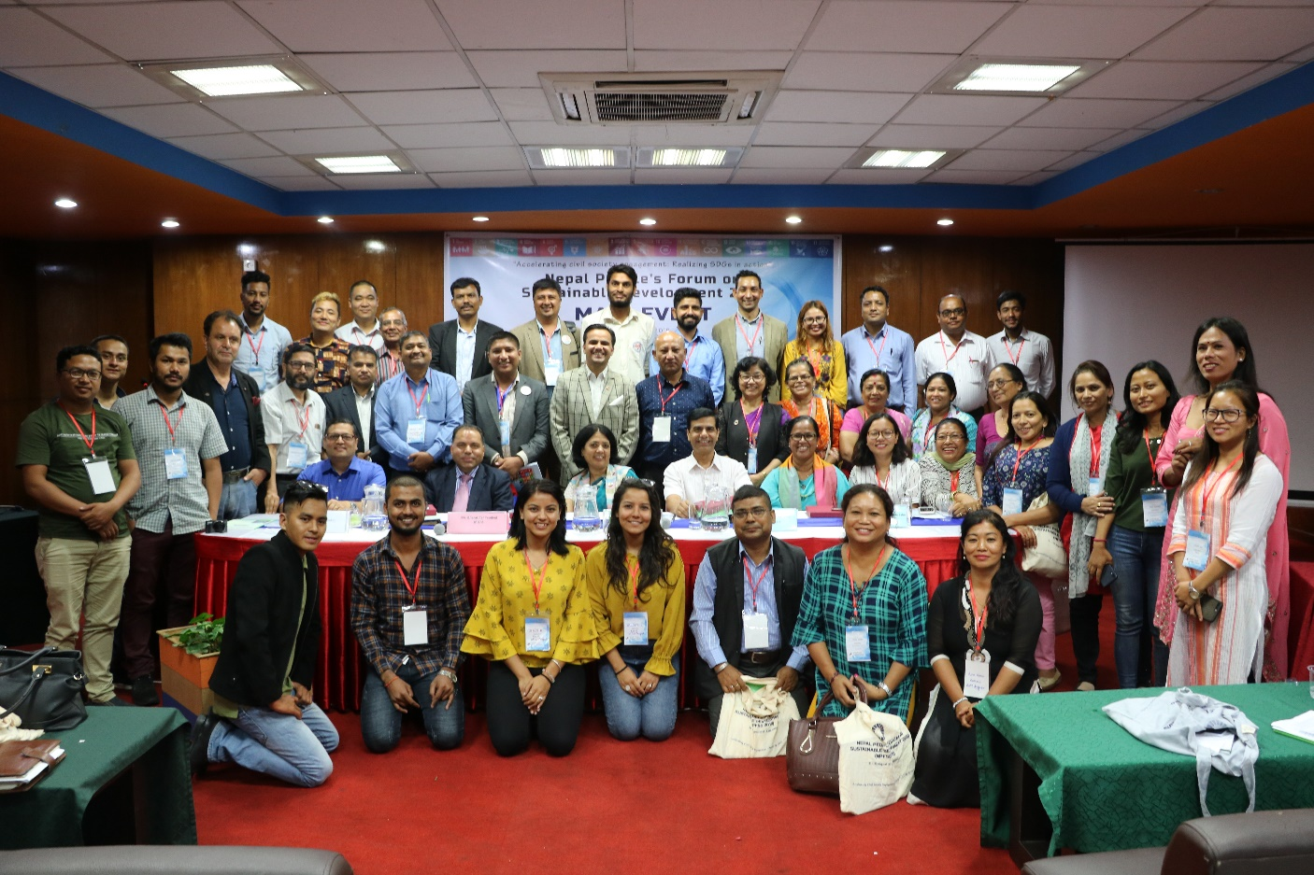
1st Nepal Peoples Forum on Sustainable Development 2019: 22 August 2019

Slide 6
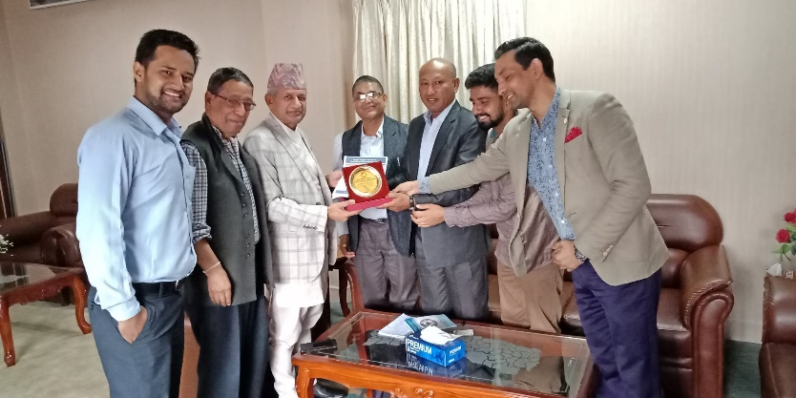
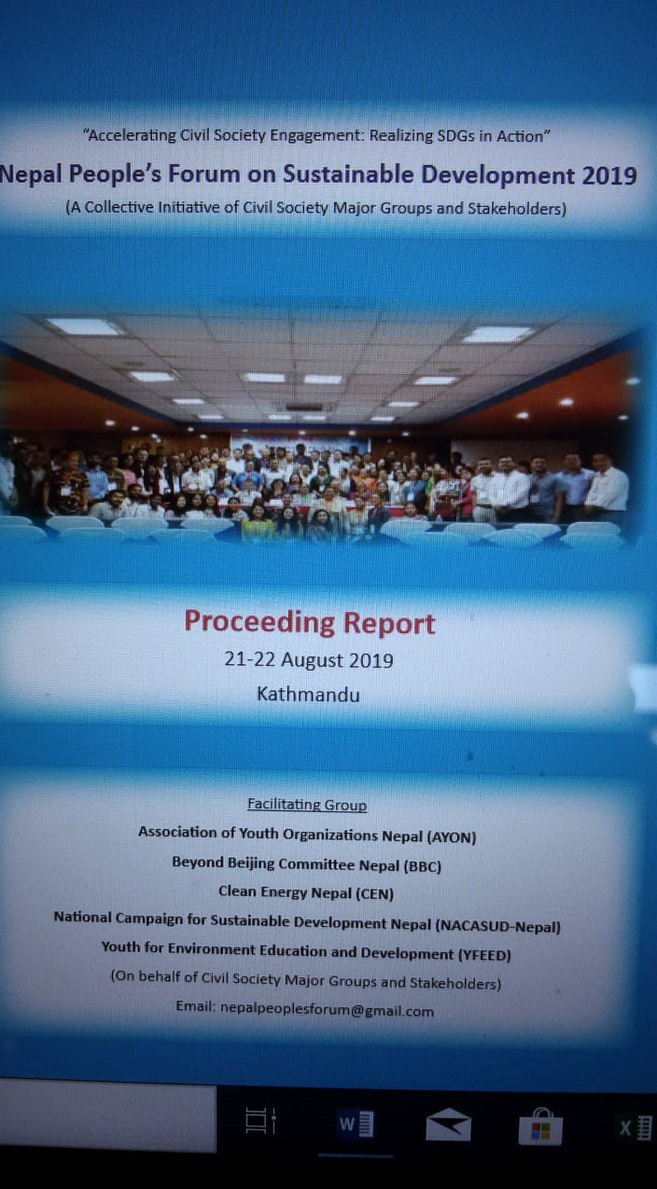
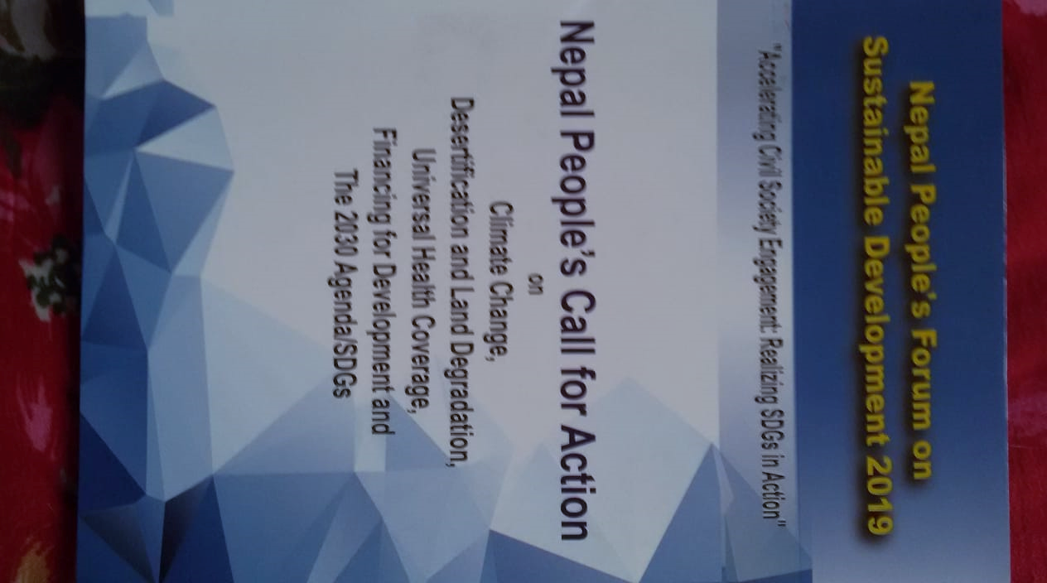
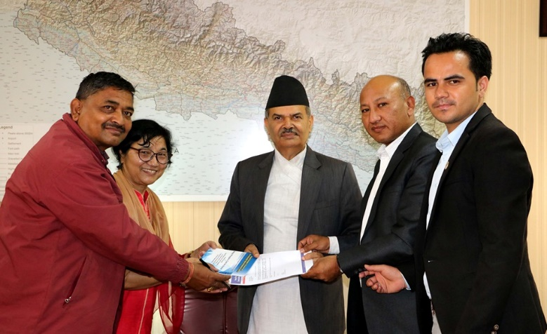
Main outcomes

Slide 7
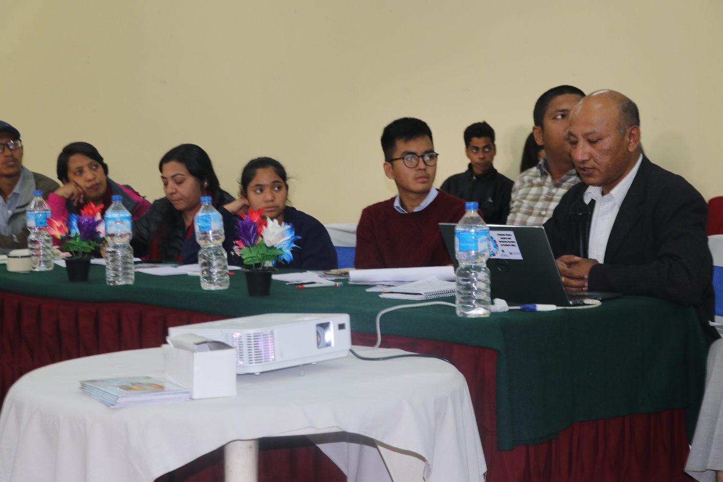
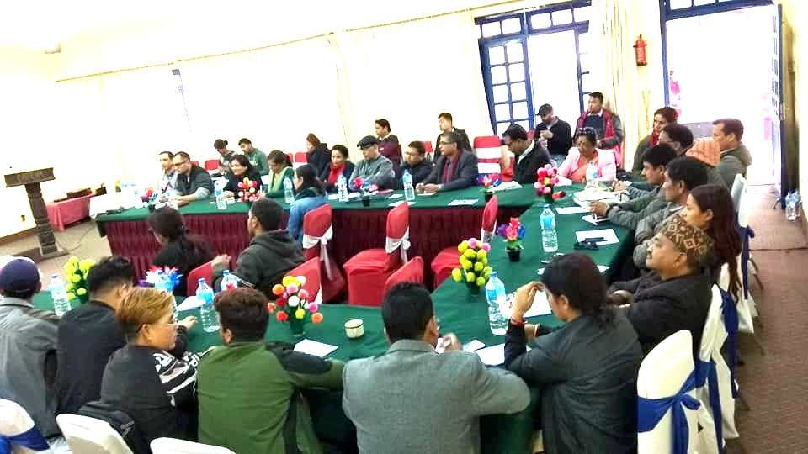
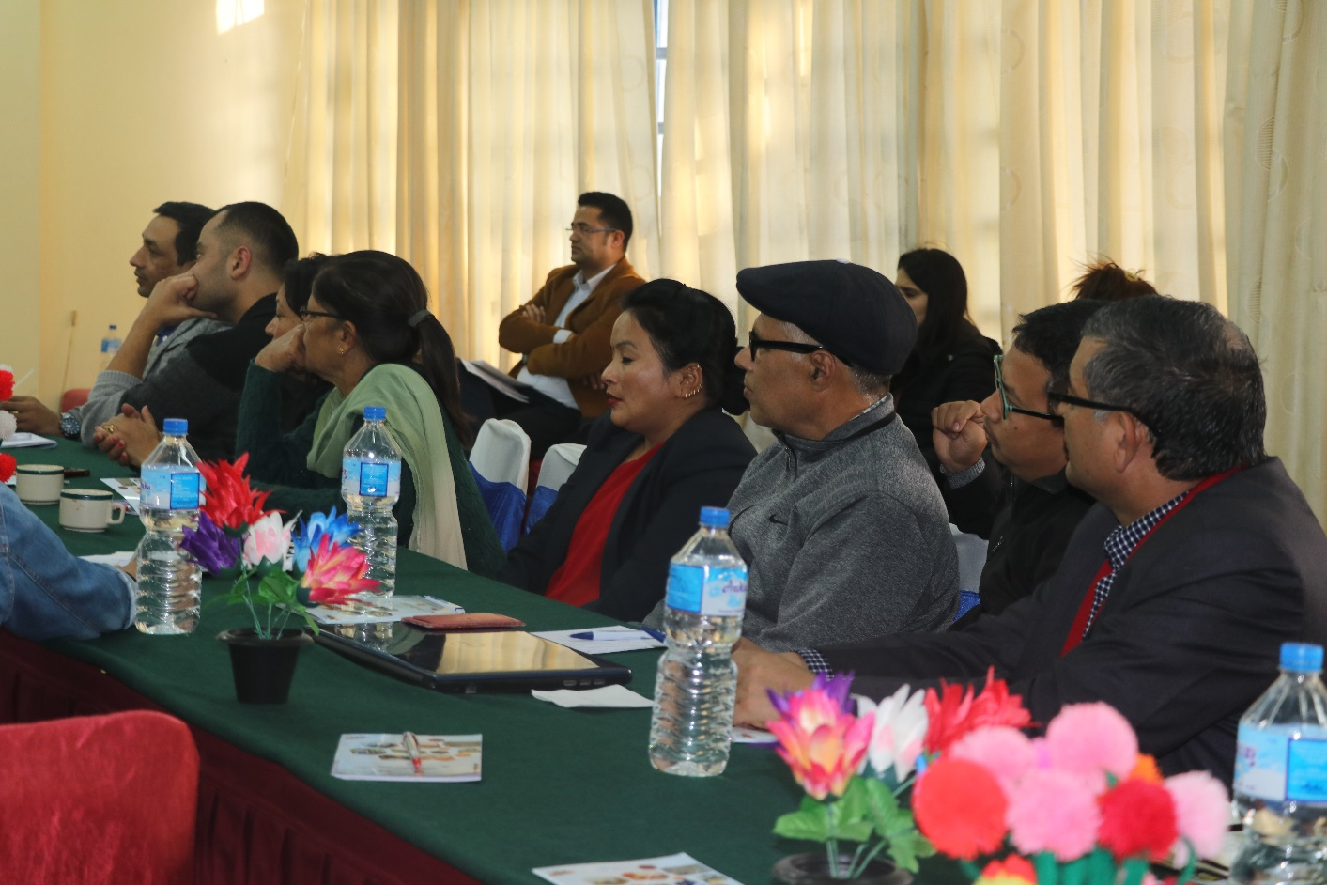
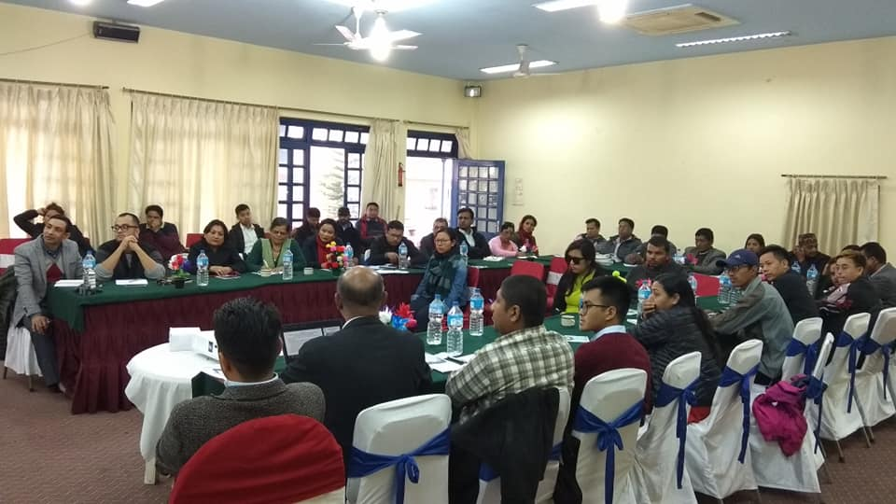
Assembly of CSOs on 25 November 2019 formed SDGs National Network Nepal

Slide 8
VPR 2020: Objective
Review progresses and achievements made by the country on UN 2030 Agenda through peoples' perspectives
Critical review of its implementation process and institutional arrangements
Assess the progress status of each goal, but gender equality will remain as cross-cutting agenda of all goals
Sharing of experiences, including successes, challenges and lessons learned, with a view to accelerating the implementation of SDGs
Produce an VPR 2020 Report

Slide 9
VPR 2020: Roadmap
Preparatory meeting among civil society Major Groups and Stakeholders | 31 January
Consultation in seven provinces | February
Discussion on themes/goals at national level | March
FGDs with civil society Major Groups/Stakeholders at national level | April
Meetings with key government agencies, private sector, media, UN country team, INGOs, MDBs, academic institutions, local governments and their associations, development experts | April
Preparation of draft VPR report | May
Youth Forum on SDGs | May
2nd Nepal Peoples Forum on Sustainable Development 2020 (Broader consultation among Major Groups and Stakeholders) | May
Delegation to concerned government bodies including National Planning Commission | May
Publish VPR Report | June

Slide 10
VPR 2020: Participation, Timeline and Outcome
Participation: 23 Major Groups and stakeholders
Invitation: Governments, UNAs, INGOs, IFIs, Business sector, think-tanks
Timeline: January to June of 2020
Outcome:
"Voluntary Peoples Review on SDGs in Nepal 2020" Report
Management Arrangement
SDGs National Network Nepal, National Coordination Committee (9 organizations)
Secretariat: National Campaign for Sustainable Development Nepal
Funding:
Collection from participating individuals and organizations

Slide 11
THANK YOU

